Slide 1
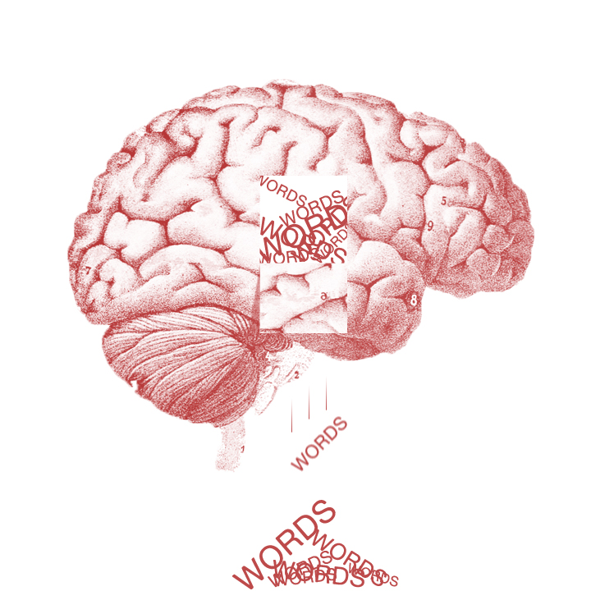
Language and the brain
Lecture 10

Slide 2
The anatomy and functions
3 issues
Lateralization, Localization, Plasticity

Slide 3
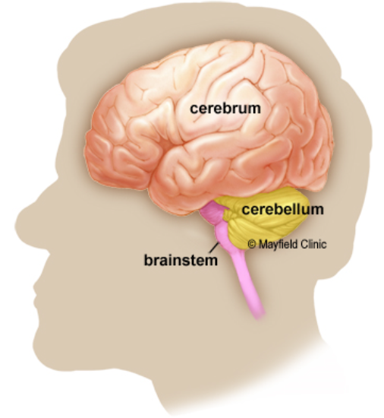
Basic structure of brain
The brain is composed of three parts:
Cerebrum
the largest part of the brain
Cerebellum
located under the cerebrum
Brainstem
acting as a relay center connecting the cerebrum and cerebellum to the spinal cord

Slide 4
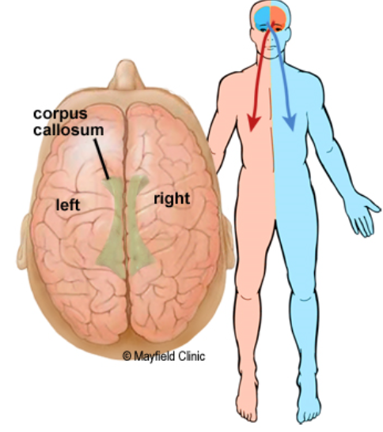
Basic structure of brain
Cerebrum
The left hemisphere controls speech, comprehension, arithmetic, and writing.
The right hemisphere controls creativity, spatial ability, artistic and musical skills.
The left hemisphere is dominant in hand use and language in about 92% of people.

Slide 5
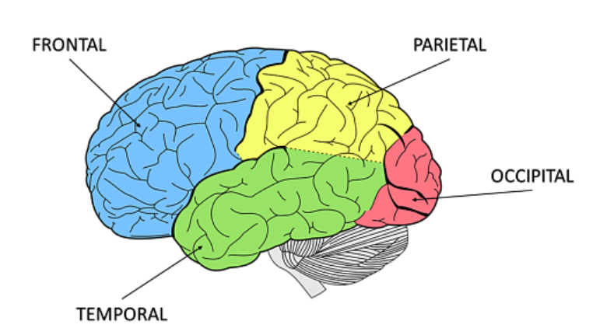
Basic structure of brain
Each hemisphere has 4 lobes:
Frontal lobe
Temporal lobe
Parietal lobe
Occipital lobe

Slide 6
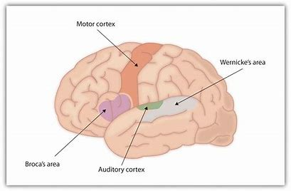
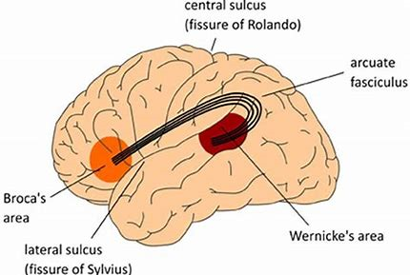
Classical Language Areas
1. Broca’s area
crucially involved in the generation of spoken language.
2. Wernicke’s area
crucially involved in the understanding of speech
3. The motor cortex
involved in the physical articulation of speech
4. The arcuate fasciculus
forming a crucial connection between Wernicke’s and Broca’s areas

Slide 7
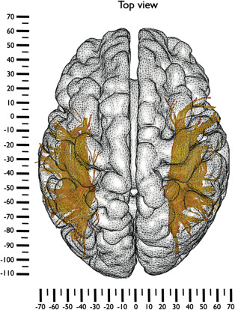
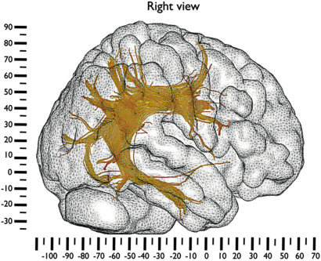
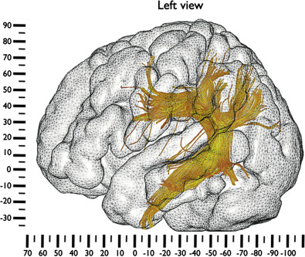

Slide 8
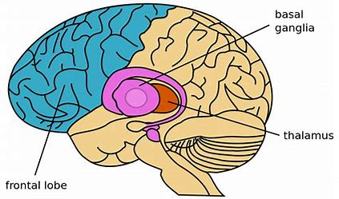
In addition to these classical language areas, language depends critically on a large number of areas and circuits in the brain.
the prefrontal cortex
appears to be involved in a variety of linguistic tasks, including various semantic aspects of language, syntax, and higher level linguistic processing, such as understanding the reasoning underlying a conversation.
the temporal lobe (connecting words to concepts, decoding speech information)
Basal Ganglia
appears to play a role not only in language production and but also in language comprehension
Cerebellum
appears to play a role in speech production and perception, as well as both semantic and grammatical processing

